Slide 1
A Deadly Meeting

Slide 2
Find your new seat. Add at least aspect of Spanish/Aztec Worldview to the Venn diagram on the whiteboard
Damon
Maida
Jayden
Rachel H.
Jesse W.
John Paul
Jesse B.
Sarah
Myranda
Isaac
Malik
Rosbean
Bailey
Rachael T.
Tommy
Ryan
Fletcher
Cassidy
Jayde
Peyton
Katelyn
Raina
Brody
Izzy
Cheyanne

Slide 3
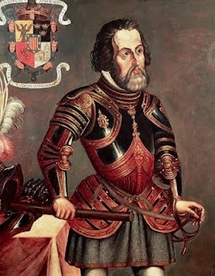
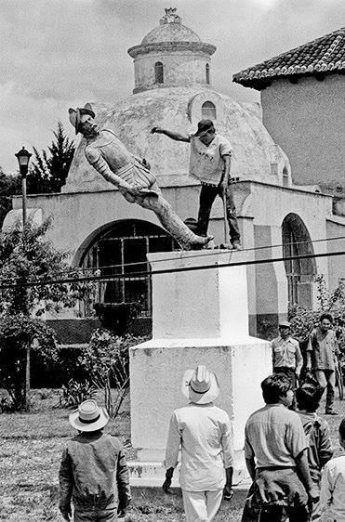
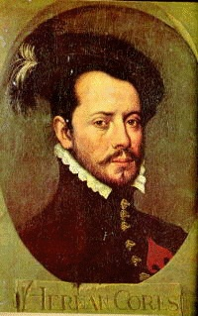
Hernan Cortes

Slide 4
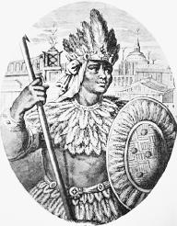
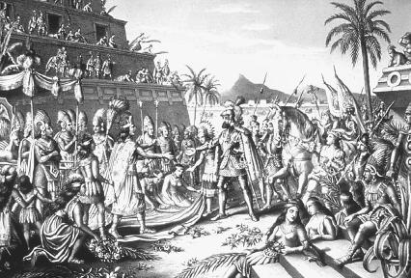
Moctezuma

Slide 5
Recipe for Conquest
Cortes was not the first to explore the New World or to capture already inhabited lands. Before capturing Tenochtitlan, Cortes visited other Spanish colonies. Conquest followed the same pattern:
Set sail from Spanish colony
Spanish land, and try to meet indigenous peoples peacefully. Try to see who holds the power
Spanish would invite indigenous leader to exchange gifts, then capture the leader and threaten to kill them if people would not obey.
If they had to fight, Spanish would fight in an open space (with horses, weapons and armour that the opposition did not have)
The Spanish leader would become the new governor of the new colony. Indigenous people were forced into slavery.

Slide 6
A little video: http://youtu.be/rrTEItqkrVQ

